Slide 1


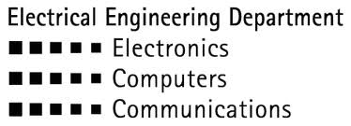

Machine Learning of a Piezoelectric Sensor for Detection of Children Abandoned in Cars
Li Adar and Tom Beer
Supervised by Alon Eilam & Yair Moshe
July 2017
Andrew and Erna Viterbi Faculty of Electrical Engineering
Signal and Image Processing Lab.

Slide 2
Motivation
In recent years, more and more children are forgotten in cars by their parents or caregivers, with tragic results
This increasing phenomenon has even been given a name: ‘Forgotten Baby Syndrome” (FBS)
In Israel, 19 children have died in 400 such cases, in the last 8 years only
Awareness raising attempts have been found fruitless
A technological approach is essential to eradicate this problem

Slide 3
Project Goal
Develop a sensor based system for use in the car
Use statistical signal processing and machine learning techniques to detect and alarm in such cases
Achieve reliable performance and increase survival rates

Slide 4
Outline
Hardware
Data acquisition and signal characterization
Prior art and our proposed approach
Feature extraction
Classification
Hysteresis
Results
Passenger detection

Slide 5
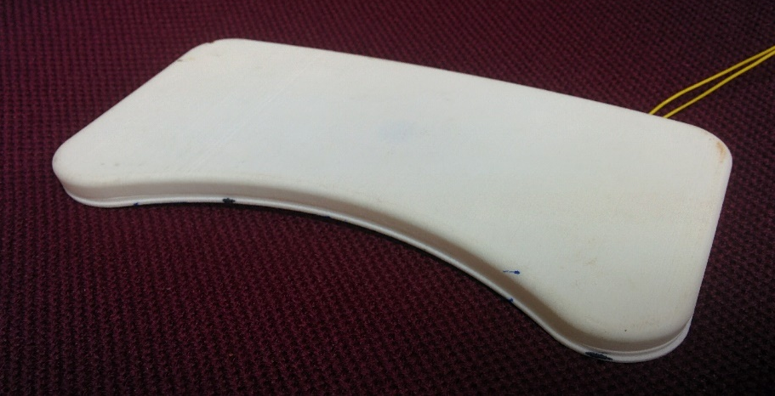
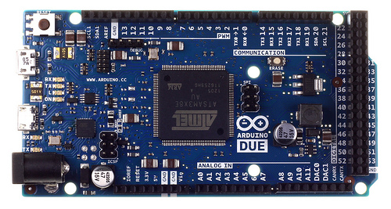
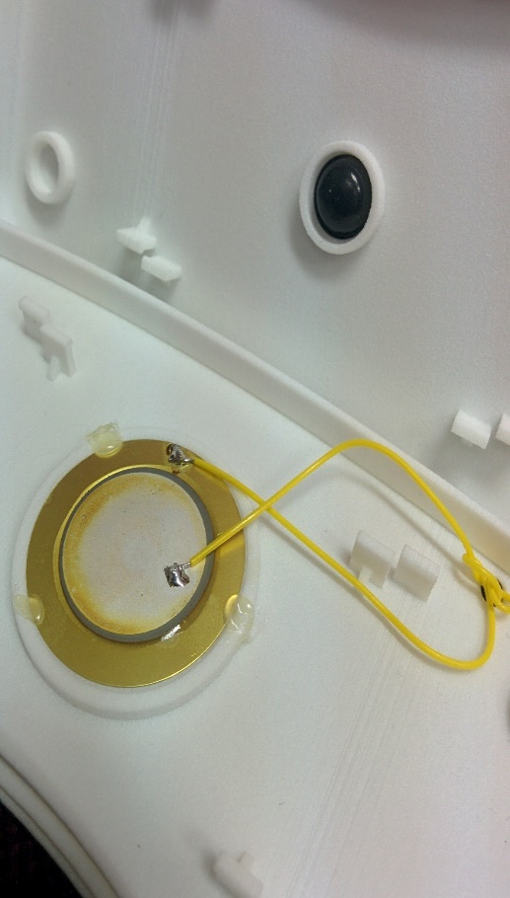
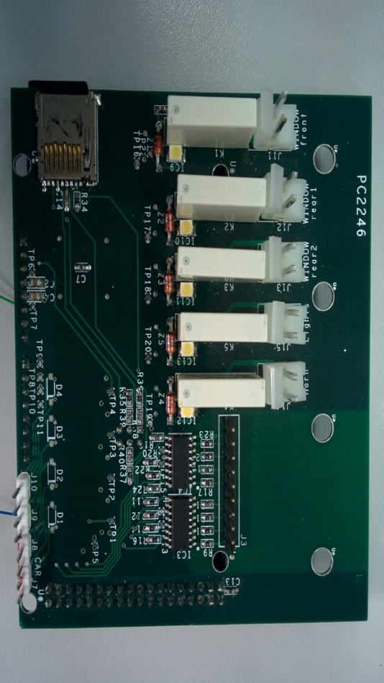
Hardware
Arduino DUE microcontroller
Interface board (microcontroller to car and sensors)
Piezoelectric sensor in custom designed package

Slide 6
Data acquisition and signal characterization
All data was acquired by us in different scenarios, 10 hours total
Signals are sampled at 1K samples per second
Obtained recordings are pressure signals similar to ones used in ballistocardiography

Slide 7
Data acquisition and signal characterization
Some kids are calm
Some are jumpy

Slide 8
Prior Art and Our Approach
Previous attempt: dual sensor fixed algorithm
Spectral analysis
Energy threshold
Hysteresis
Real time implementation
Our approach: single sensor machine learning
Wavelet transform
Machine learning classifier
Hysteresis
Real time implementation

Slide 9
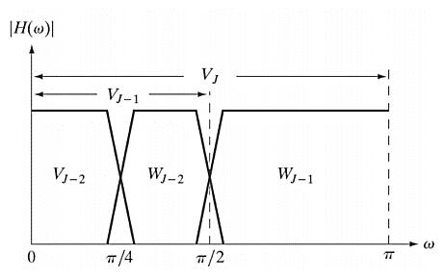
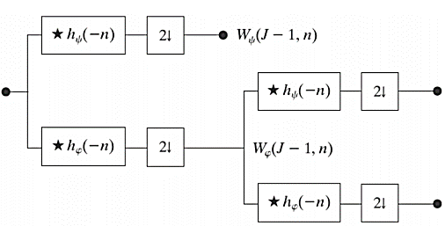
Feature Extraction
This is the process of transforming the raw data and generating relevant attributes from it
We used features that are based on the discrete wavelet transform (DWT) of the signals
This transform allows for multiresolution analysis and captures both time and frequency information of the signals

Slide 10
Classification
This is the discrimination of observations to categories via a statistical model
Many classification algorithms were tested, including:
LDA
KNN
SVM
Logistic regression
Decision trees
Naïve Bayes
Parameters were tuned for each classifier and we compared between their optimal performances

Slide 11
Hysteresis
Low error rates are critical for this task: misdetections may be fatal and false alarms reduce reliability
On the other hand, a delay of a few seconds is harmless
The idea is to use this delay to output decisions with higher certainty

Slide 12
Results – feature extraction block
Wavelet filter selected
Level of decomposition
Number of used coefficients

Slide 13
Results – Wavelet Selection (1)
Notes:
דגשים: מה כל עקומה בגרף אומרת
להסביר מה זה משפחות פילטרים
בכל משפחה יש סדר מסנן משתנה
רואים שככל שסדר המסנן עולה, הביצועים יורדים

Slide 14
Results – Wavelet Selection (2)

Slide 15
Results – Wavelet Selection (3)
Variance of performance for different wavelets is relatively small (range ~0.3-1.8)
Fejer-Korovkin of order 6 (fk6) achieved the lowest error rate
For most wavelet families, performance decreases as higher order filters are used.

Slide 16
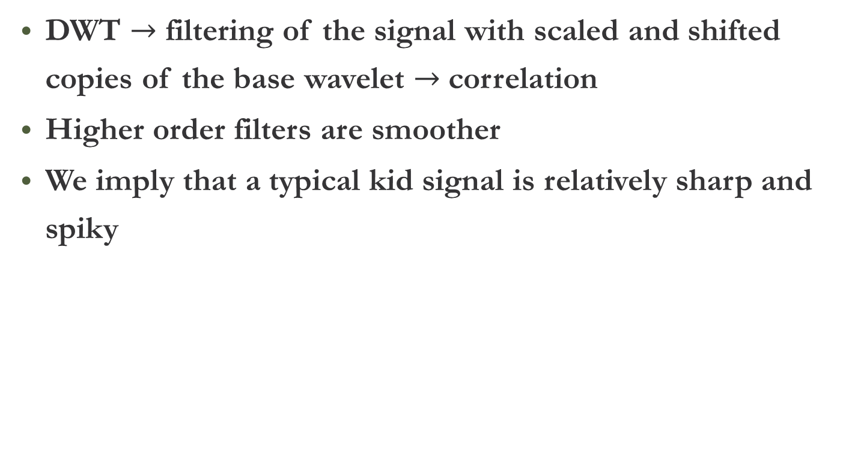
Results – Wavelet Selection (4)
DWT $→$ filtering of the signal with scaled and shifted copies of the base wavelet $→$ correlation
Higher order filters are smoother
We imply that a typical kid signal is relatively sharp and spiky

Slide 17
Results – Decomposition Levels (1)
Optimal decomposition level is 8
Higher decomposition levels provide more detail in low frequencies

Slide 18
Results – Decomposition Levels (2)
In the optimal decomposition level (8), the lowest band is [0,2]Hz
In decomposition level 9, the lowest band is [0,1]Hz
We infer that frequencies below 1Hz do not carry valuable information
Moreover, training with this irrelevant information decreases performance, due to overfitting

Slide 19
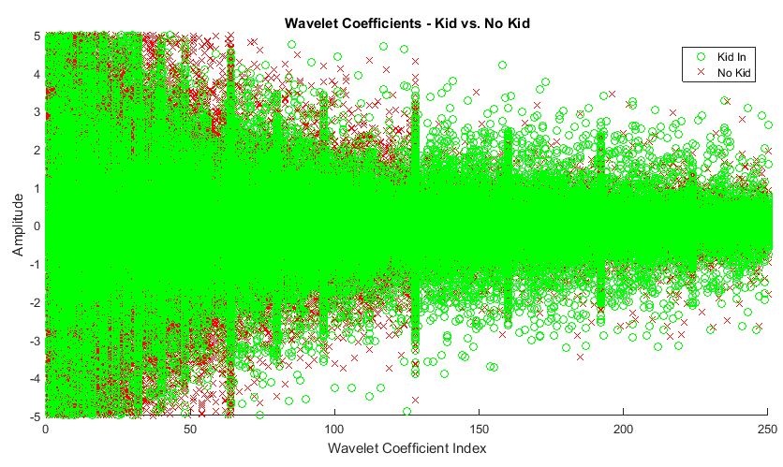
Results – Wavelet Coefficients Number (1)

Slide 20
Results – Wavelet Coefficients Number (2)
The coefficients were not the only features used - statistical attributes of each sub band were added to the feature vector: min, max, mean, std
Optimal number of coefficients is 50

Slide 21
Results – Wavelet Coefficients Number (3)
Statistical attributes proved to be very helpful

Slide 22
Results – Wavelet Coefficients Number (4)
The statistical attributes might be the reason that even with 0-5 coefficients- error rate is still around 1%
Performance decreases as we increase the coefficient number beyond some value
Similarly to previous result, this is due to overfitting
Here, discarded coefficients contain high frequency irrelevant information

Slide 23
23
Results – Classification Overview
All classifier lost to KNN in performance

Slide 24
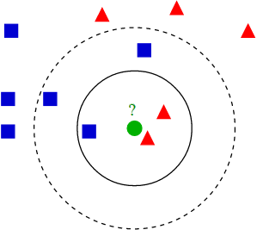
Results – KNN
The KNN classifier has a three main parameters:
Number of nearest neighbors (K)
Distance metric
Distance weight
Unsurprisingly, performance increased for larger K with distance weighting

Slide 25
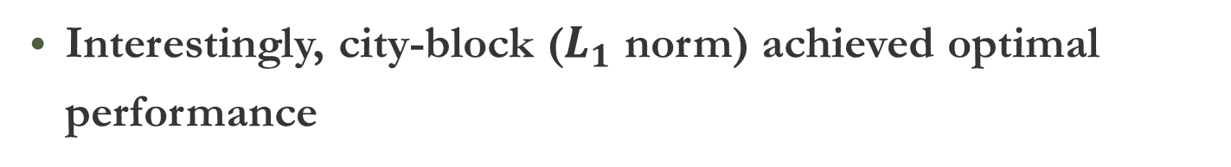
Results – KNN: Distance Metric (1)
Interestingly, city-block ($L_{1}$ norm) achieved optimal performance

Slide 26
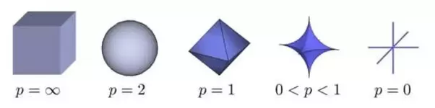
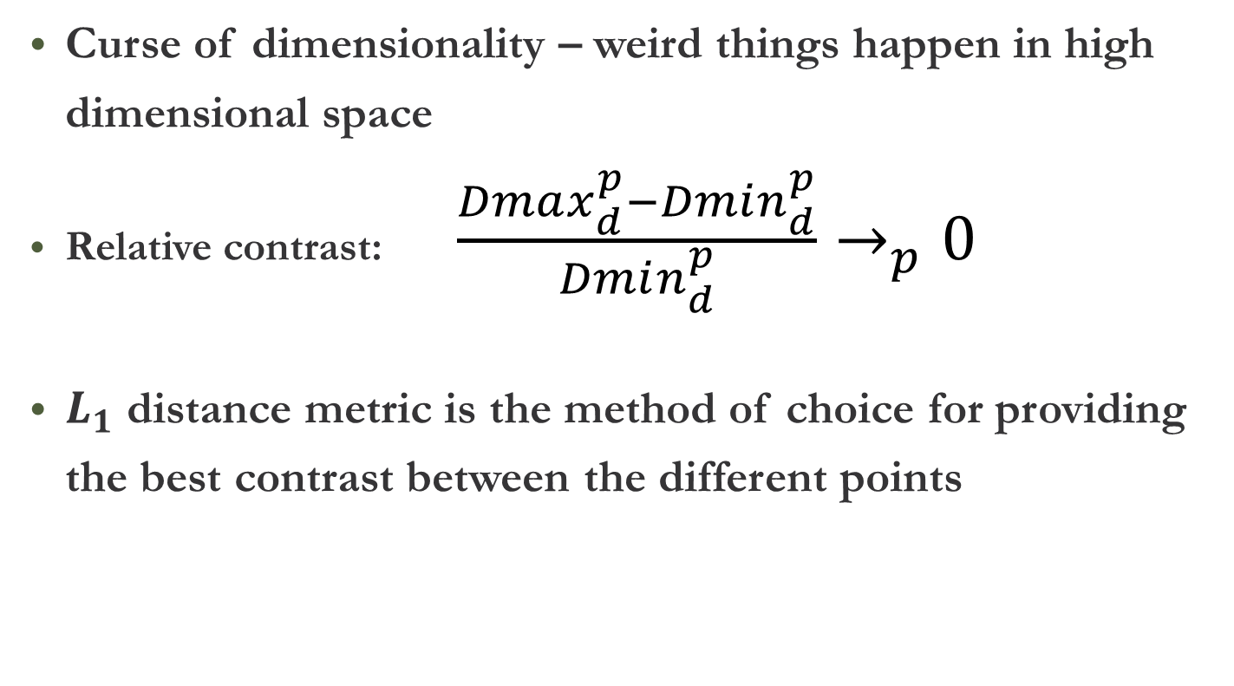
Results – KNN: Distance Metric (2)
Curse of dimensionality – weird things happen in high dimensional space
Relative contrast: $\frac{Dmax_{d}^{p}−Dmin_{d}^{p}}{Dmin_{d}^{p}}→_{p}0$
$L_{1}$ distance metric is the method of choice for providing the best contrast between the different points

Slide 27
Results – Hysteresis
With optimal value 14 we reached an error rate of under 0.1%
Above this value, the algorithm responds slowly to changes

Slide 28
Error Analysis
It is worthwhile to analyze the source and distribution of classification errors
Potential to gain insight into how the algorithm works and how it can be improved
Two questions:
Do the errors originate from several specific recordings, or are they found in many experiments?
Do the errors come in sequential frames (bursts) or are they scattered uniformly across time?

Slide 29
Error Analysis

Slide 30
Error Analysis
Histogram counts errors for many runs
Out of 155 recordings:
84% never had a single error
4% always had some errors
The rest were inconsistent: sometimes they had 100% success rate, sometimes they had errors

Slide 31
Error Analysis
As for the second category (experiments with errors every run):
Appeared in both classes (false alarms and miss-detects)
Some frames always had errors, others did not
No more than 2 sequential frames with errors (no bursts)
We believe these errors originate from dataset imperfections
Errors in the third category (inconsistent) originate from model imperfections

Slide 32
Real time operation
Wavelet transform, LDA classifier and hysteresis were implemented on Arduino microcontroller
Real-time computation measurements were made in order to make sure the 2 seconds time limit is held
Full compatibility with Matlab simulation was achieved
Arduino Due has very limited RAM memory size - affects our ability to implement real-time filtering
Not all algorithms are suitable for Arduino implementation, due to memory and run-time limitations

Slide 33
(Almost) Live Demo

Slide 34

Passenger Detection (1)
Can we improve the poor false positive rates of common seat belt detectors?
A greater challenge: signals from driving are noisy
New database: 4 hours of recordings from a driving car

Slide 35
Passenger Detection (2)

Slide 36
Passenger Detection (3)
This was not our initial target - more like a proof of concept, suggesting an interesting sequel
Without testing any further optimizations, the error rate is ~1%
This is a good starting point for further work

Slide 37
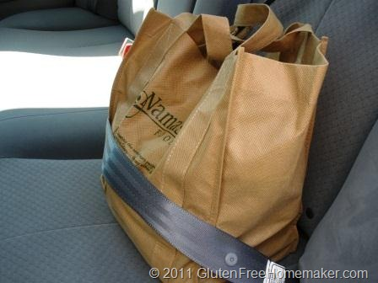
Passenger Detection (4)
The tradeoff is between quick response (low hysteresis) and high accuracy (high hysteresis)
Unlike the child-detection scenario, providing immediate response is more critical

Slide 38
Achievements and Future Work
We developed a machine learning based system for the detection of children forgotten in cars.
We acquired a diverse dataset of more than 10 hours of recordings
We developed a machine learning and feature extraction simulation, for which we executed a full scale optimization
We implemented a real-time operational version of the algorithm on a standalone microcontroller

Slide 39
Achievements and Future Work
Our work showed that child detection in cars can be done with error rates as low as 0.07% - that is one error every 1400 data samples, or a single error every hour.
Future improvements:
Feature engineering
Dimensionality reduction/larger training base
Deep learning
Notes:
Deep learnin ידע לקבוע את הפרמטרים האופטימליים בעצמו

Slide 40



Thank you

